Slide 1
OSDA Big Homework: Neural FCA UCI Acute Inflammations Dataset Exploring Interpretability and Efficiency in Classification Tasks
Faculty of Computer Science
OSDA Big Homework
Moscow 2024
The presentation was prepared by Muhammad Zeeshan Asghar

Slide 2

Dataset Description
Data science
OSDA Big Homework
Dataset Description
/ 31
The UCI Acute Inflammations dataset is a collection of patient records, including six features (five binary and one numerical) and two target variables (bladder inflammation and nephritis).
Features: 6 attributes, 5 binary (e.g., nausea, lumbar pain) and 1 continuous
(temperature)
Targets:
– Bladder Inflammation (Cystitis): Binary classification (0 = no, 1 = yes)
– Nephritis: Binary classification (0 = no, 1 = yes)

Slide 3
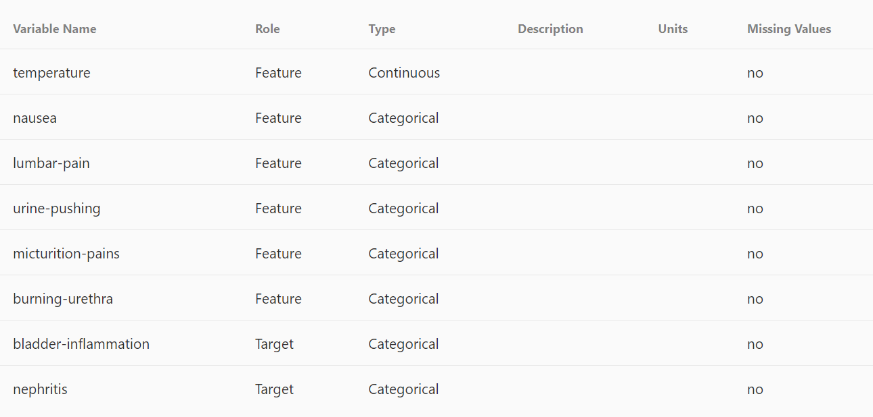
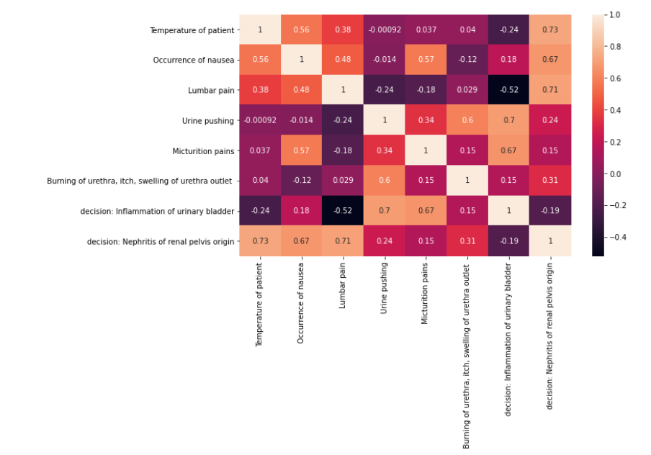
Dataset
Data science
OSDA Big Homework
Dataset
/ 31

Slide 4
Prediction quality measure
Data science
OSDA Big Homework
Prediction quality measure
/ 31
Target 1:
Bladder Inflammation (Cystitis): 60 positive and 60 negative samples.
Balance Score = 1
We can use F1 score or accuracy for evaluation
Target 2:
Nephritis: 50 positive and 70 negative samples.
Balance Score = 0.714
We should use F1 score for evaluation

Slide 5
Approach Overview
Data science
OSDA Big Homework
Approach Overview
/ 31
Evaluate binarization methods for the temperature attribute.
Compare two concept selection metrics: F1 score and accuracy.
Investigate the impact of activation functions on Neural FCA performance.
Benchmark Neural FCA against traditional classifiers, like Logistic Regression and Random Forest.

Slide 6
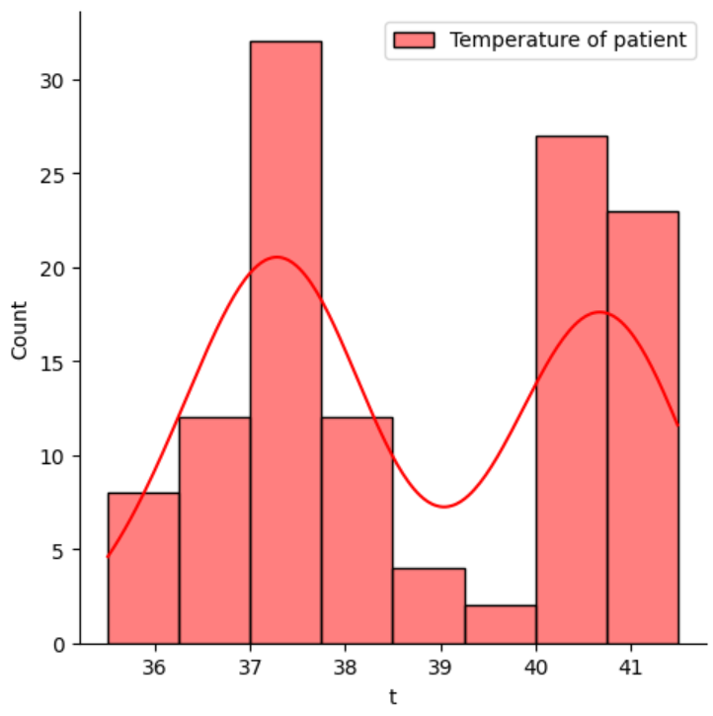
First Binarization Approach
Data science
OSDA Big Homework
First Binarization Approach
/ 31
We see that the temperature readings are mostly between either 37-37.5 degrees or 40-41.5 degrees.
- Threshold: 38°C
- Categorization:
- High Temperature: Temperatures > 38°C
- Low Temperature: Temperatures ≤ 38°C
Rationale:
- Source: The threshold is based on the World Health Organization (WHO) definition of fever, which considers a temperature above 38°C as indicative of a fever. This provides a legitimate and widely accepted basis for the threshold.
- Data Distribution: The data shows a clear distinction around 38°C, with fewer samples around this point, making it a suitable cutoff.

Slide 7
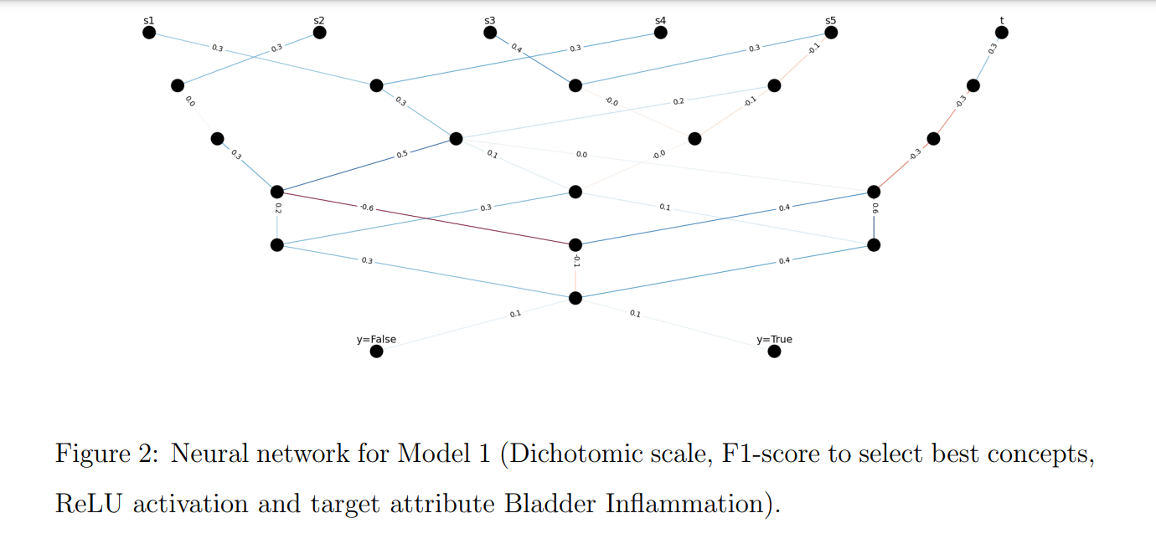
First Binarization Result for diagnosing Bladder Inflammation
Data Science
OSDA Big Homework
First Binarization Result for diagnosing Bladder Inflammation
/ 31

Slide 8
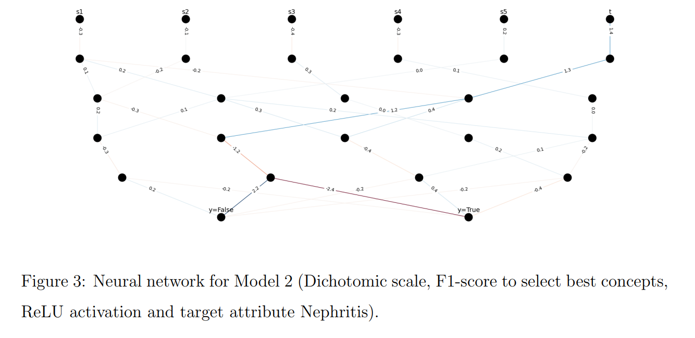
First Binarization Result for diagnosing Nephritis
Data Science
OSDA Big Homework
First Binarization Result for diagnosing Nephritis
/ 31

Slide 9
Second Binarization Approach
Data science
OSDA Big Homework
Second Binarization Approach
/ 31
For the second approach we used ordinal scale to binarize the temperature.
• Temperature ≤ 36.5: Categorized as ”Normal”
• Temperature ≤ 37.5: Categorized as ”Normal” or ”Elevated”
• Temperature ≤ 41.5: Categorized as ”Normal” or ”Elevated” or ”Fever”
This approach captures intermediate states.
Rationale:
Human body temperature by wikipedia https://en.wikipedia.org/wiki/Human_body_temperature

Slide 10
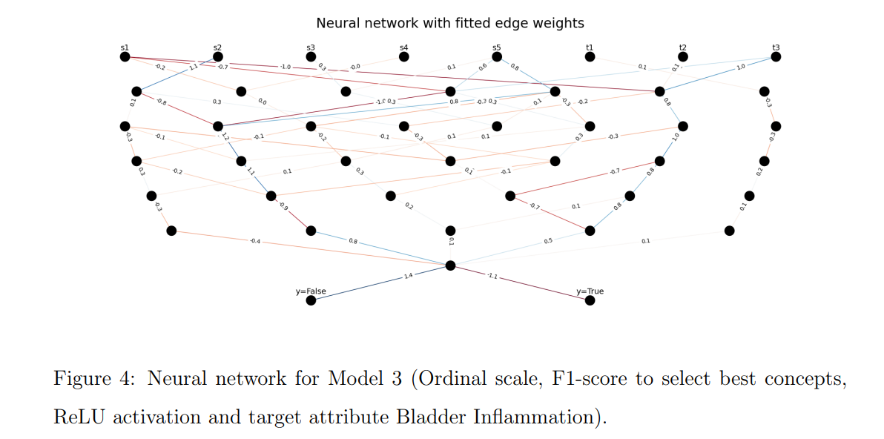
Second Binarization Result for diagnosing Bladder Inflammation
Data Science
OSDA Big Homework
Second Binarization Result for diagnosing Bladder Inflammation
/ 31

Slide 11
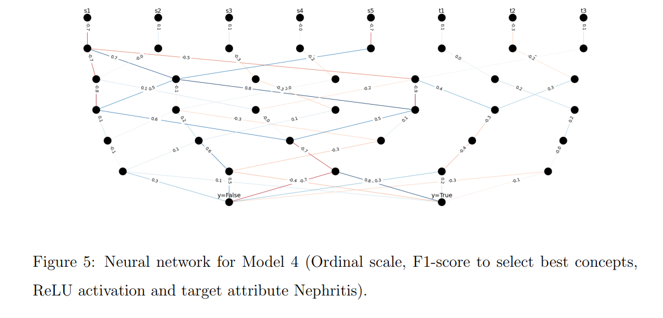
Second Binarization Result for diagnosing Nephritis
Data Science
OSDA Big Homework
Second Binarization Result for diagnosing Nephritis
/ 31

Slide 12
Another Approach for selecting best concepts
Data science
OSDA Big Homework
Another Approach for selecting best concepts
/ 31
Let’s use accuracy instead of F1 score to select best concepts to apply neural network on. We will test this on both binarized techniques.

Slide 13
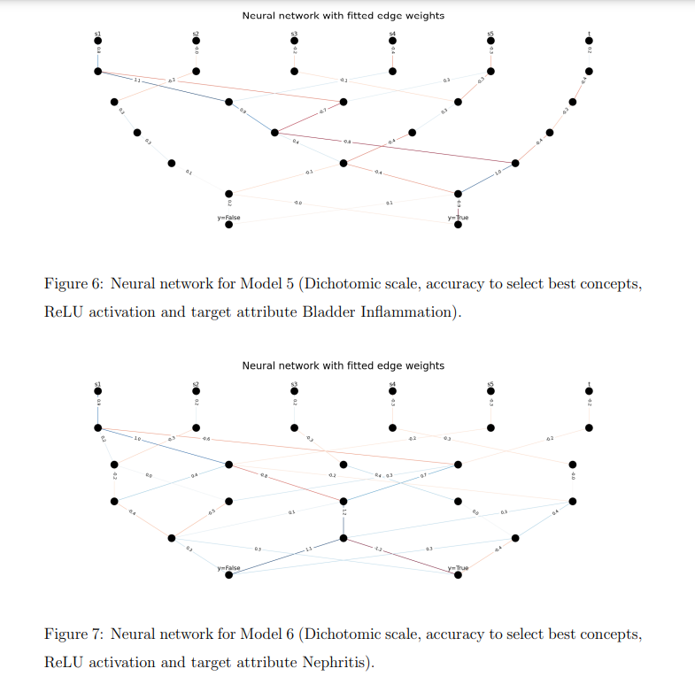
First Binarization Result for diagnosing Bladder Inflammation
Data Science
OSDA Big Homework
First Binarization Result for diagnosing Bladder Inflammation
/ 31

Slide 14
First Binarization Result for diagnosing Nephritis
Data Science
OSDA Big Homework
First Binarization Result for diagnosing Nephritis
/ 31

Slide 15
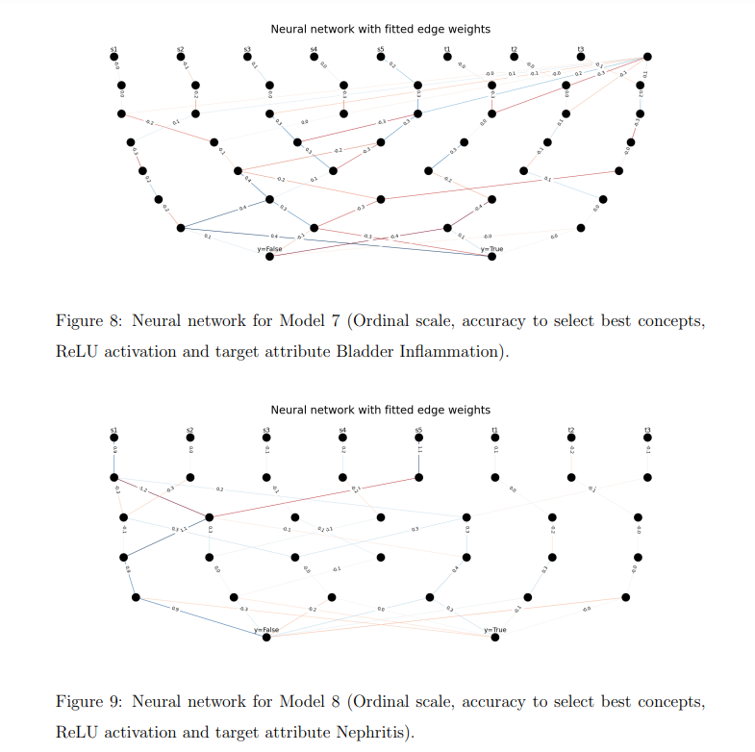
Second Binarization Result for diagnosing Bladder Inflammation
Data Science
OSDA Big Homework
Second Binarization Result for diagnosing Bladder Inflammation
/ 31

Slide 16
Second Binarization Result for diagnosing Nephritis
Data Science
OSDA Big Homework
Second Binarization Result for diagnosing Nephritis
/ 31

Slide 17
Using different Activation function
Data Science
OSDA Big Homework
Using different Activation function
/ 31
The default nonlinearity in the network is ReLU. Let's use our first and best model, i.e. using F1 score to select best concepts, to test Leaky ReLU and hyperbolic tangent.

Slide 18
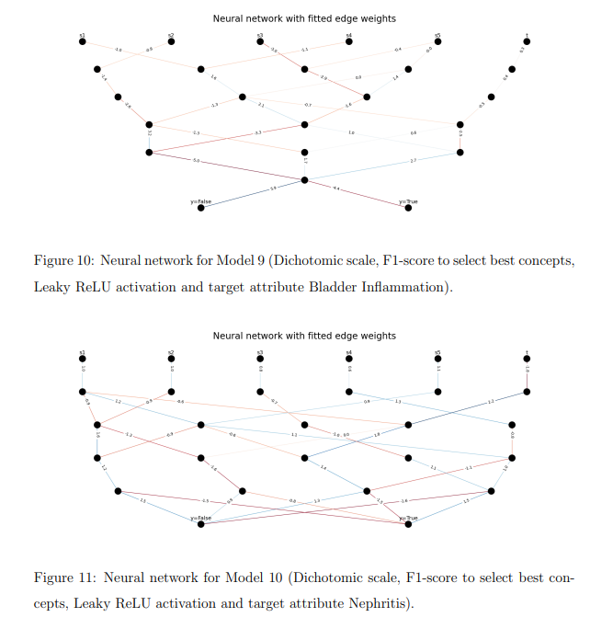
Leaky ReLU with Dicromatic Scale Binarization Result for diagnosing Bladder Inflammation
Data Science
OSDA Big Homework
Leaky ReLU with Dicromatic Scale Binarization Result for diagnosing Bladder Inflammation
/ 31

Slide 19
Leaky ReLU with Dicromatic Scale Binarization Result for diagnosing Nephritis
Data Science
OSDA Big Homework
Leaky ReLU with Dicromatic Scale Binarization Result for diagnosing Nephritis
/ 31

Slide 20
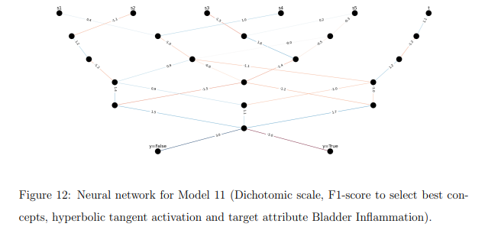
Hyperbolic Tangent with Dicromatic Scale Binarization Result for diagnosing Bladder Inflammation
Data Science
OSDA Big Homework
Hyperbolic Tangent with Dicromatic Scale Binarization Result for diagnosing Bladder Inflammation
/ 31

Slide 21
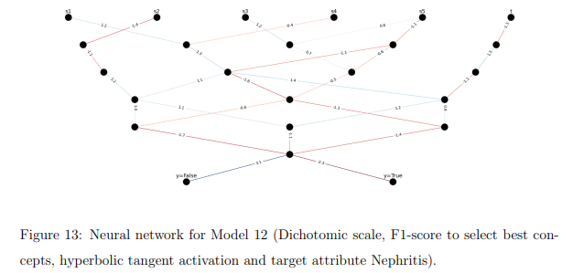
Hyperbolic Tangent with Dicromatic Scale Binarization Result for diagnosing Nephritis
Data Science
OSDA Big Homework
Hyperbolic Tangent with Dicromatic Scale Binarization Result for diagnosing Nephritis
/ 31

Slide 22
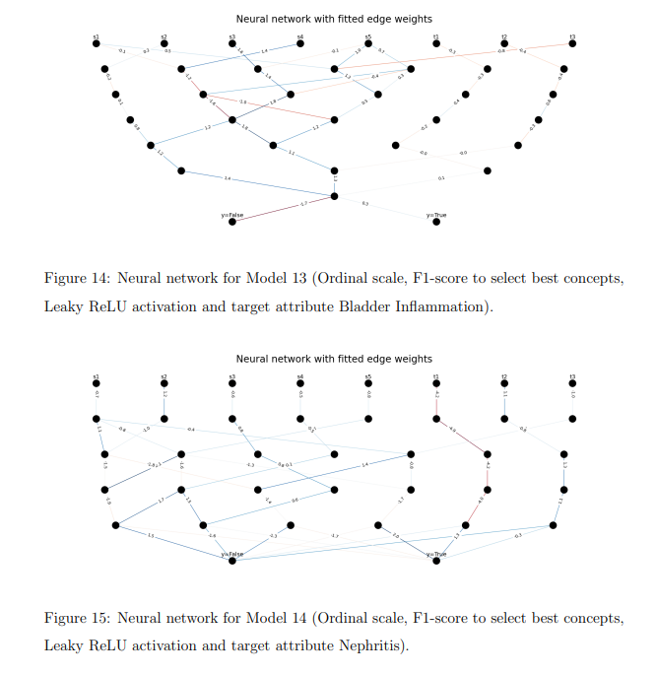
Leaky ReLU with Ordinal Scale Binarization Result for diagnosing Bladder Inflammation
Data Science
OSDA Big Homework
Leaky ReLU with Ordinal Scale Binarization Result for diagnosing Bladder Inflammation
/ 31

Slide 23
Leaky ReLU with Ordinal Scale Binarization Result for diagnosing Nephritis
Data Science
OSDA Big Homework
Leaky ReLU with Ordinal Scale Binarization Result for diagnosing Nephritis
/ 31

Slide 24
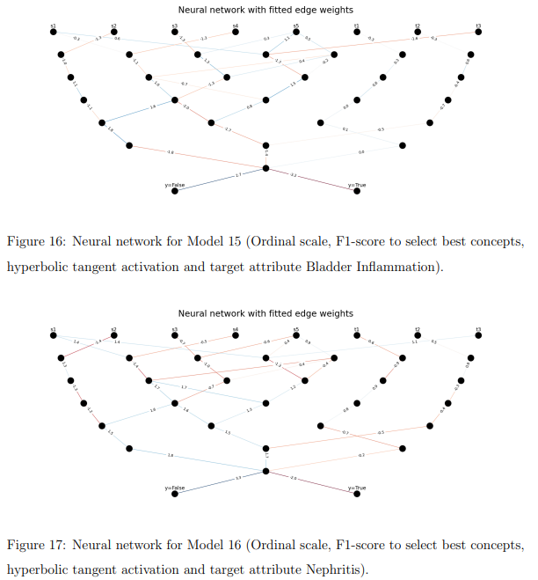
Hyperbolic Tangent with Ordinal Scale Binarization Result for diagnosing Bladder Inflammation
Data Science
OSDA Big Homework
Hyperbolic Tangent with Ordinal Scale Binarization Result for diagnosing Bladder Inflammation
/ 31

Slide 25
Hyperbolic Tangent with Ordinal Scale Binarization Result for diagnosing Nephritis
Data Science
OSDA Big Homework
Hyperbolic Tangent with Ordinal Scale Binarization Result for diagnosing Nephritis
/ 31

Slide 26
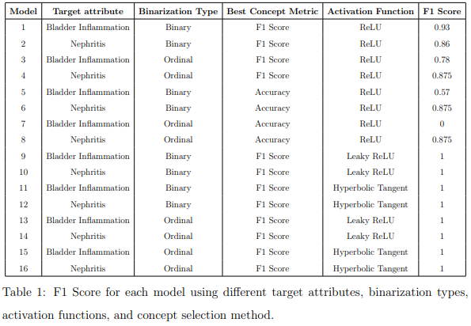
Neural FCA Performance
Data Science
OSDA Big Homework
Neural FCA Performance
/ 31

Slide 27
Insights from Weighted Neural Networks
Data Science
OSDA Big Homework
Insights from Weighted Neural Networks
/ 31
Visualization of the neural network’s weighted edges provided valuable insights into feature importance:
Temperature: Had a strong influence on both targets, indicating its critical role in diagnosing fever-related conditions.
Lumbar Pain: Was particularly significant for predicting Nephritis, highlighting its relevance to kidney-related symptoms.
Urine Pushing and Micturition Pains: Were crucial for Bladder Inflammation prediction.

Slide 28
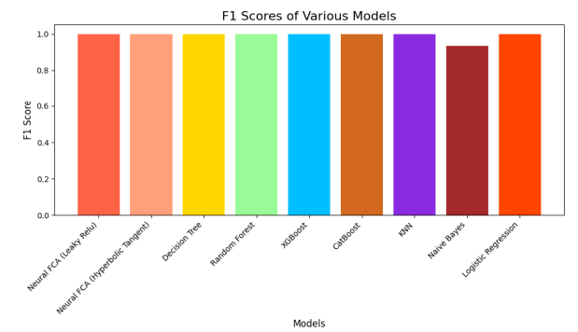
Comparison with State-of-the-Art Approaches
Data Science
OSDA Big Homework
Comparison with State-of-the-Art Approaches
/ 31

Slide 29
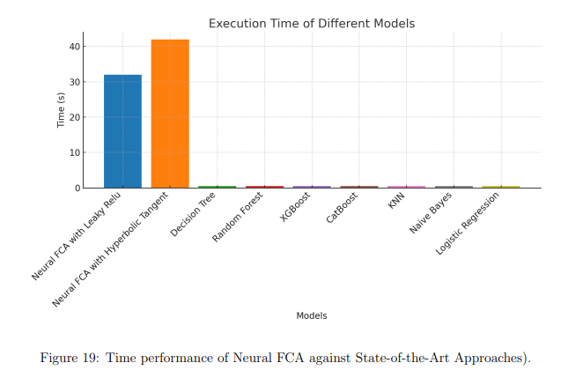
Comparison with State-of-the-Art Approaches
Data Science
OSDA Big Homework
Comparison with State-of-the-Art Approaches
/ 31

Slide 30
Conclusion
Data Science
OSDA Big Homework
Conclusion
/ 31
Neural FCA provided excellent interpretability through concept lattices and visualizations, which offered a deeper understanding of the relationships between attributes and target outcomes. The results underscore the importance of the activation function choice, with Leaky ReLU and Tanh significantly improving performance over ReLU.
However, the method’s computational complexity limits scalability for larger datasets.
Further optimizations, such as more efficient lattice construction or pruning of irrelevant concepts, could enhance performance.

Slide 31
References
Data science
2D SLAM Project: Occupancy Grid Mapping with Scan Matching, FastSLAM and Particle Filters
References
/ 31
UCI Acute Inflammations Dataset (https://archive.ics.uci.edu/dataset/184/acute+inflammations)’
Human Body Temperature Binarization (https://en.wikipedia.org/wiki/Human_body_temperature)
World Health Organization (WHO) Definition of Fever (https://www.who.int/data/gho/indicator-metadata-registry/imr-details/180)

